Slide 1
Lecture 5b Algorithm Analysis 2

Slide 2
Summary: Already done
Need for analysis
Empirical and theoretical analysis
Time efficiency, space efficiency, …
Definition of order of growth (Big-Oh) and measuring time efficiency
Theorem – order of growth of polynomial functions
Worst-case, Best-case and Average-case analysis
Elementary operations
Basic operations

Slide 3
Summary of this lecture
Importance of efficiency
Other asymptotic notations
Properties of asymptotic notations
Extended version of theorem for polynomial functions

Slide 4
Importance of efficiency

Slide 5
Importance of efficiency
n=100000, Δ=1μs
t_{n}=log₂n*Δ 16 μs
n* Δ 0.1 s
n.log₂n 1.6 s
n² 3 h
n³ 32 years
2^{n} 3.10³⁰⁰⁸⁹ years
No need to write Δ

Slide 6
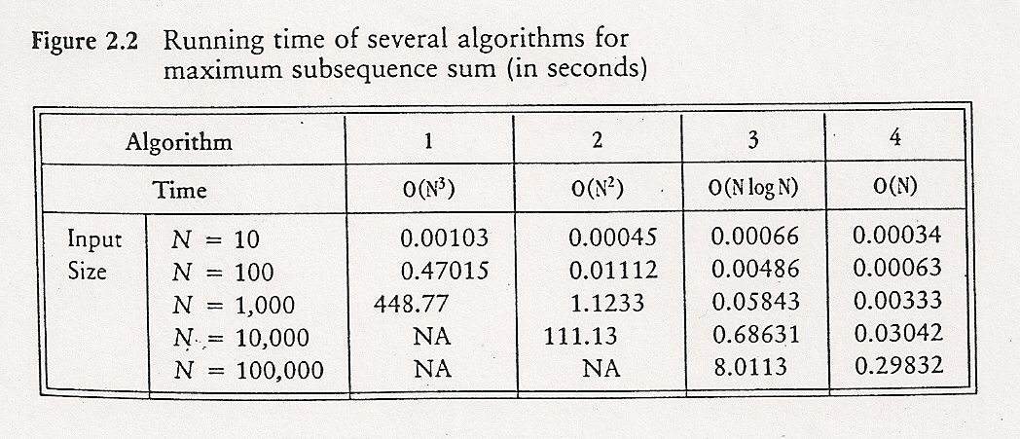
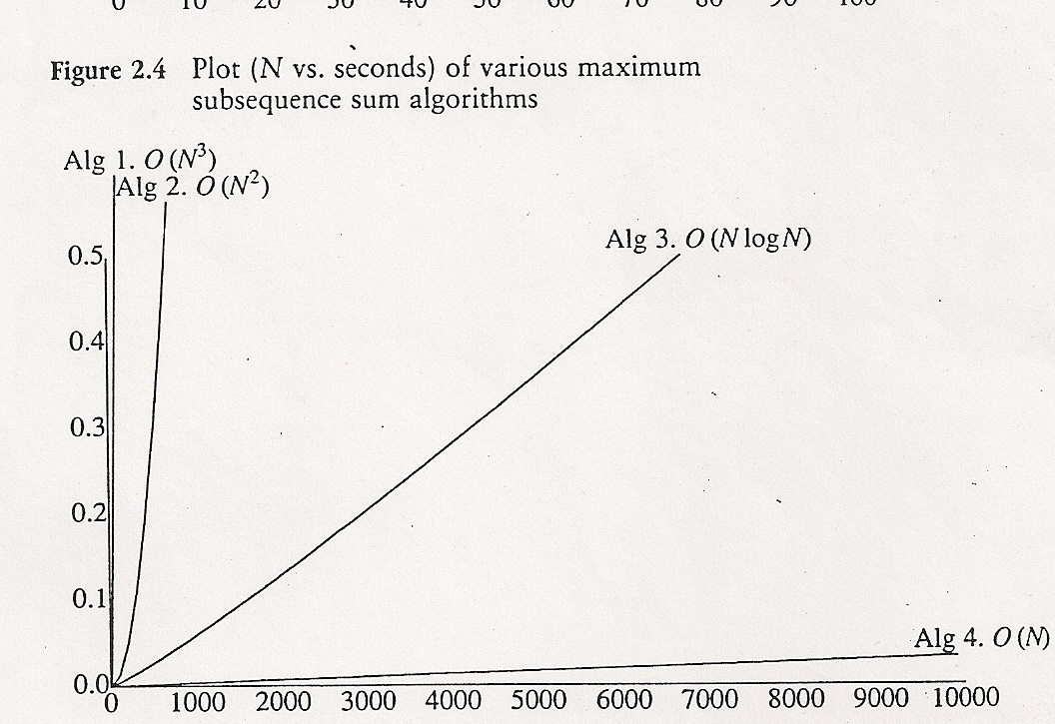
≈7.5 min
≈2 min

Slide 7
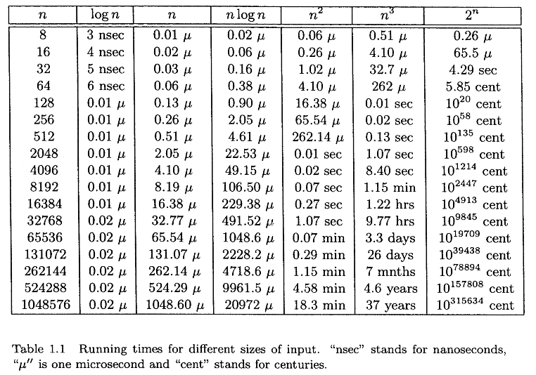
Assuming f(n) shows the number of operations and one operation takes 1 ns

Slide 8
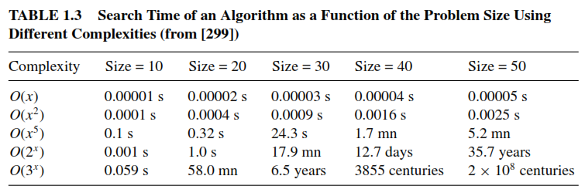
Importance of Efficiency
From Talbi - Metaheuristics

Slide 9
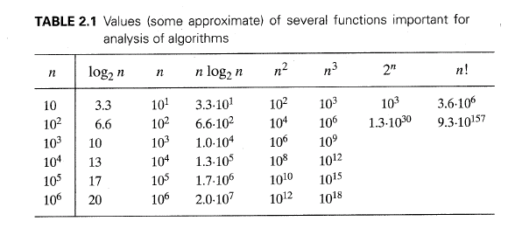
Already given earlier

Slide 10
Other Asymptotic Notations
f(n)=O(g(n)) ↔ ∃c∈R^{>0},∃n₀∈N,∀n≥n₀: f_{n}≤cg(n)
f(n)=Ω(g(n)) ↔ ∃c∈R^{>0},∃n₀∈N,∀n≥n₀: f_{n}≥cg(n)

Slide 11
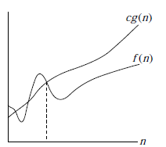

Other Asymptotic Notations
Recall: t(n) = O(g(n)) ↔
∃c∈R^{≥0}, n₀∈N, ∀n≥n₀: t(n) ≤ cg(n)
t(n)
More precisely – only discrete points
n_{o}

Slide 12
Other Asymptotic Notations
t(n)=Ω(g(n)) ↔ ∃c∈R^{>0},∃n₀∈N,∀n≥n₀: t_{n}≥cg(n)
n_{o}

Slide 13
Other Asymptotic Notations
f(n)=Θ(g(n)) ↔ f(n)=O(g(n)) & f(n)=Ω(g(n)) ≅
t(n)=Θ(g(n)) ↔ ∃c₁,c₂∈R^{>0},∃n₀∈N,∀n≥n₀:
c₁g(n)≤f_{n}≤c₂g(n)

Slide 14
Other Asymptotic Notations
f(n)=Θ(g(n)) ↔ f(n)=O(g(n)) & f(n)=Ω(g(n)) ≈
t(n)=Θ(g(n)) ↔ ∃c₁,c₂∈R^{>0},∃n₀∈N,∀n≥n₀:
c₁g(n)≤f_{n}≤c₂g(n)

Slide 15
Other Asymptotic Notations
f(n)=o(g(n)) ↔ ∀c∈R^{>0},∃n₀∈N,∀n≥n₀: f_{n}<cg(n)
f(n)=ω(g(n)) ↔ ∀c∈R^{>0},∃n₀∈N,∀n≥n₀: f_{n}>cg(n)

Slide 16
Other Asymptotic Notations
Equivalently
f(n)=o(g(n)) ↔ f(n)=O(g(n)) & f(n)≠Ω(g(n))
f(n)=o(g(n)) ↔ f(n)=O(g(n)) & f(n)≠Θ(g(n))
f(n)=ω(g(n)) ↔ f(n)=Ω(g(n)) & f(n)≠O(g(n))
f(n)=ω(g(n)) ↔ f(n)=Ω(g(n)) & f(n)≠Θ(g(n))

Slide 17
Other Asymptotic Notations
Analogy with numbers

Slide 18
Asymptotic notations
Most important: O, Θ
Best evaluation: Θ

Slide 19
Properties of Asymptotic Notations

Slide 20
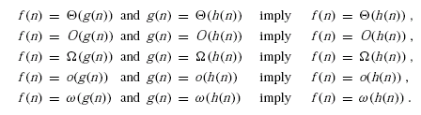
Properties of Asymptotic Notations
Transitivity
f(n) = O(g(n)) and g(n) = o(h(n)) imply f(n) = o(h(n))
f(n) = o(g(n)) and g(n) = O(h(n)) imply f(n) = o(h(n))
Similarly with ω

Slide 21
Example
Standard method for calculating a polynomial
Recall t(n) = O(n²)
but also, ∀n≥1 (1≤n) n²≤n³ ↔ n² = O(n³)
t(n) = O(n²) & n² = O(n³)
∴ t(n) = O(n³)
Which characterization of t(n) is better?

Slide 22
Example

Slide 23
Can we also prove that
t(n) = o(n³)

Slide 24
Example
t(n) = O(n²)
also, ∀n≥1 n²≤n³ ↔ n² = O(n³)
Actually
∀n>1 n²<n³ ↔ n² = o(n³)
∴ t(n) = o(n³)

Slide 25
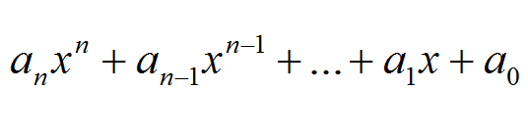
Recall: Theorem
25
If t(n) is a polynomial
t(n) =
of power n and a_{n}>0 then
t(n)=O(x^{n})

Slide 26
!! This Theorem can be extended
If t(n) is a polynomial
t(n) =
of power n and a_{n}>0 then
t(n)=Θ(x^{n})
t(n)=o(x^{g}) for any g>n
t(n)=ω(x^{s}) for any s<n
26

Slide 27
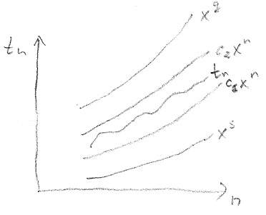

Slide 28
For example
t(n)=Θ(x³)
t(n)=o(x⁴)
t(n)=o(x⁵)
…
t(n)=ω(x²)
t(n)=ω(x)
t(n)=ω(1)

Slide 29
For the polynomial Example
We have proven
t(n) = O(n²)
t(n) = o(n³)
t(n) = o(n³)
…
Let us prove
t(n)=Ω(n²) and therefore t(n)=Θ(x²)
t(n)=ω(x)
…

Slide 30
Recall
t(n) = 10⁻⁶*(n² + 2n) ≤
≤ 3*10⁻⁶*n²
t(n) ≤ 3*10⁻⁶*n²
t(n) = O(n²) for c=3*10⁻⁶ , n₀=1

Slide 31
For the polynomial Example
t(n)=10⁻⁶*(n² + 2n) ≥ [n≥0] 10⁻⁶*(n² + 2.0) =
= 10⁻⁶*n²
t(n) ≥ 10⁻⁶*n²
t(n)=Ω(n²) for c=10⁻⁶ n_{o}=0

Slide 32
For the polynomial Example
32

Slide 33
Summarize
t(n) = O(n²)
t(n) = Ω(n²)
Therefore: t(n)=Θ(n²)
To be precise, if t is time, for t_{n}= Ω(n²) we need to bound the times for the elementary operations (addition and multiplication) from below as well.

Slide 34
Use Simplest Form
It is not a good style to write
t(n)=O(2n³+3n²)
Instead, use the simplest form
t(n)=O(n³)

Slide 35
Summary (last two lectures)
Need for analysis
Empirical and theoretical analysis
Time efficiency, space efficiency, …
Definition of order of growth (Big-Oh) and measuring time efficiency
Theorem – order of growth of polynomial functions
Worst-case, Best-case and Average-case analysis

Slide 36
Summary (last two lectures)
Elementary operations
Basic operation
Importance of efficiency
Other asymptotic notations
Properties of asymptotic notations
Extended version of theorem for polynomial functions
Notes:
36

